Slide 1
Using Goals to Assess Future Program Strategies
Assessing Program Strategy Using the Goals Model

Slide 2
Purpose
Estimate the cost and impact of different program strategies.
Results will be useful for planning and resource mobilization.
Approach
Use the model to simulate coverage scale-up to meet future targets
Assess impact, cost and cost-effectiveness

Slide 3
Scenarios to Consider
Scenario | Description
Fast-Track | UNAIDS Fast-Track strategy for ending AIDS as a public health threat by 2030. Includes 90-90-90 treatment targets as well as aggressive scale-up of other prevention interventions
National Strategic Plan (NSP) | Use Goals to evaluate the costs and impact of fully implementing your NSP
National targets (Global Fund Performance Framework) | Achievable targets for 2020 as reflected in your Global Fund funding request, or your national implementation plan, or other feasible targets
Optimization | Given a trend available funding through 2020, estimate the optimum allocation of those resources by intervention. How much impact can be produced? How close do we get to Fast-Track goals?

Slide 4
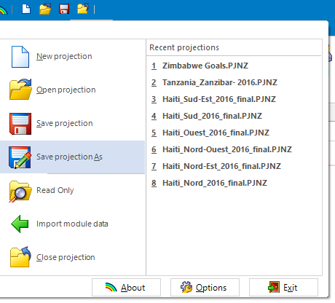
Save a new copy of your file for each scenario
Fast-Track
NSP
Global Fund Performance Framework

Slide 5
Specify the coverage targets for 2020
Program or Behavior | Location in Spectrum
Set program coverage to scale-up from current coverage to target coverage by 2020
PMTCT | AIM -> Program statistics -> PMTCT
Adult ART | AIM -> Program statistics -> Adult ART
Pediatric ART | AIM -> Program statistics -> Child treatment
Pediatric co-trimoxazole | AIM -> Program statistics -> Child treatment
VMMC | Goals -> Male circumcision
PrEP | Goals -> Coverage -> PrEP
Define scale-up of behavior change interventions
General population interventions Condoms, community mobilization, cash transfers, etc. | Goals -> Coverage –> General population
Key population interventions Outreach to key populations, OST | Goals -> Coverage -> Key populations

Slide 6
Creating the Fast-Track scenario
Goals -> Coverage
General population
Most-at-risk populations
Male circumcision
PrEP
AIM -> Program statistics
PMTCT
Adult ART
Child ART
Goals -> Epidemiology -> ART effect
Intervention | 2020 | 2030
Condoms | 90% | 90%
Cash transfers | 30% | 50%
Sex worker outreach | 90% | 90%
MSM outreach | 90% | 90%
PWID outreach | 90% | 90%
OST | 40% | 40%
Male circumcision | 90% | 90%
PrEP: Medium risk, high risk, MSM | 10% | 30%
PMTCT | 95% | 95%
ART | 81% | 90%
ART effect | 0.10 | 0.05

Slide 7
New Infections and AIDS Deaths by Scenario

Slide 8
Resources Required

Slide 9
Impact and Cost-Effectiveness

Slide 10
Naming your files
Historical scenarios
COUNTRYNAME_Goals Base file with no changes
COUNTRYNAME_no program Using 2001 coverage values
Future scenarios
COUNTRYNAME_Base Using 2016 coverage through 2020
COUNTRYNAME_Goals_FT Reach fast track targets by 2020
COUNTRYNAME_Goals_NSP Reach NSP targets by 2020
COUNTRYNAME_Goals_GF (or _other) Reach Global Fund proposal targets by
2020
Once you run the optimization scenario the new file will be named “xxx_optimized”

